Slide 1
Contents
Research Question
City Conditions
  logical data needed to explore this
  data sources
Catalysts
  logical data needed to explore this
  data sources
Draft data model
Future Extensions

Slide 2
Research Question
Context
Much is innovations is centred in London and the South east
There is a desire to drive digital and creative innovation in the regions
To support this our research will show:
  Where cluster of innovation geographically within the uk
  Where businesses are based and growing in tech and creative
  The conditions that might support grow across the country

Slide 3
City Conditions
Data source Companies house/ crunchbase
Data source Companies house/ crunchbase
No of companies
No of companies by sector classifications
TBD
No of start ups
Data source : ONS
Labour Market# - no employment, unemployed, claimants, inactive
City Business & Economic factors
Local Business rates?
TBD
Note cities 20K plus as defined by ONS large cities

Slide 4
Catalysts
Data source: TBD
Incubators
Data source: crunchbase
Office space cost
accelerator
Investors
Data source: Nesta
Data source: Crunchbase
Co-working space
Maker spaces
Data source: ONS
Broadband
Enablers and Catalysts
Job Types
Data source: data.gov.uk
Open signal?
Talent
Jobs by sector
Meet ups - Tech
Tech City Survey
Data source: TBD
Data source: Uk tech City
Data source: TBD

Slide 5
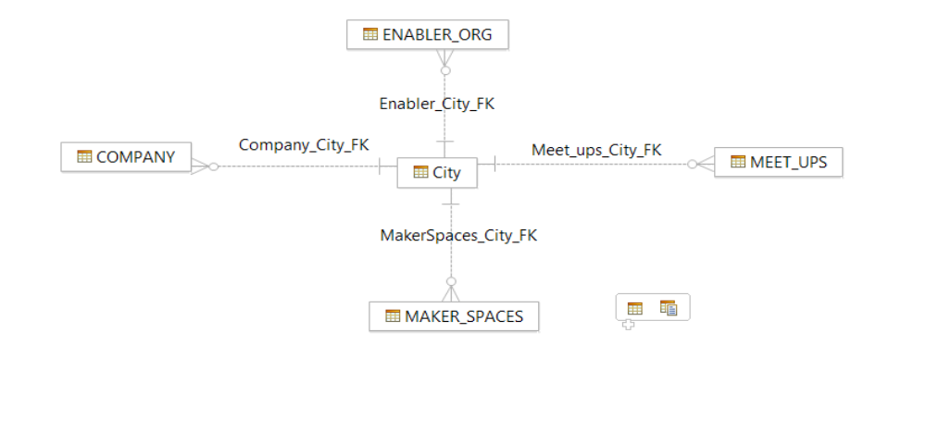
Data Models

Slide 6
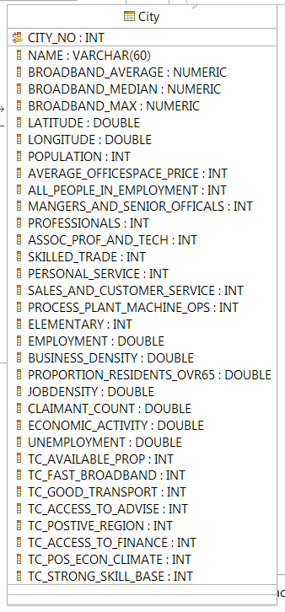
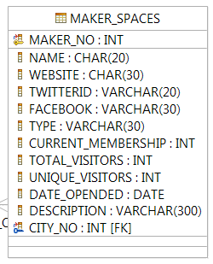
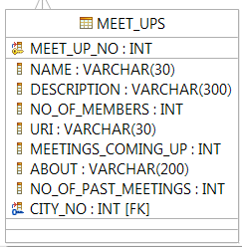
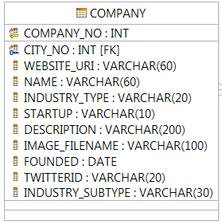
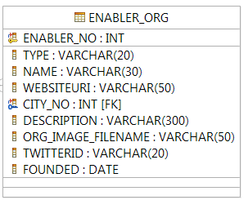
Data Models
Tables

Slide 7
Data Models

Slide 8
Possible future extension
??
Road Links
Rail links
??
Extensions
??

